Slide 1
For Live Session: Unit 3
By Justin Ehly

Slide 2
For Live Session: Unit 3
Part 1: We would like to analyze the Left Midfielders (LM) versus the Left Forwards (LF). (Estimated / expected time: 2 – 4 hours and at least 2+ slides).
Using the FIFA player data set, filter the data set to create a dataframe that has just the Left Midfielders (LM) and Left Forwards (LF).
Use Ggally and ggpairs() and the dataset you created above above, to plot the categorical variable Position (LM and LF), versus the continuous variables Acceleration and Agility.
Given the plot above, what relationships do you see? Comment on these.
Your client would like to formally test if the mean agility rating of left midfielders is different than that of the left forwards. Perform a 6 – step t-test to test for the difference in these means. (You may skip step 2 (draw and shade) if you like. If you are unfamiliar with the 6-step hypothesis test, see Stat 1 slides or the Bridge Course to review the 6-step hypothesis test.)
Are the assumptions of this test reasonably met? If you have not had Stat 1, simply create a histogram of the agility scores for both groups (LM and LF) and given what you know about the CLT, comment on if you believe the sampling distribution of sample means (of your sample size) will be reasonably normal. In addition, does there look like there is significant visual evidence to suggest the standard deviations are different? ….. If you have had Stat 1, create the plots listed above (and any other plots you might prefer) and be prepared to be a teacher and teach what you know about the assumptions of the t-test and if those are assumption are reasonably met here.

Slide 3
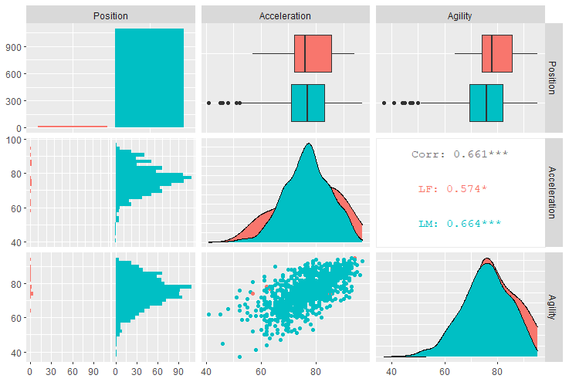
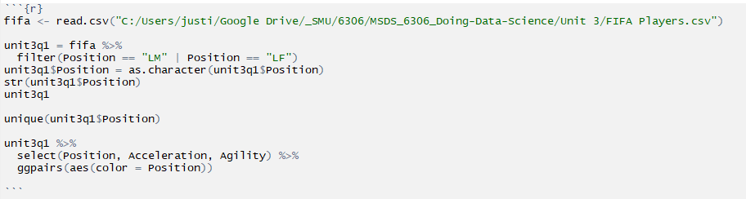
Part 1: We would like to analyze the Left Midfielders (LM) versus the Left Forwards (LF).
Using the FIFA player data set, filter the data set to create a dataframe that has just the Left Midfielders (LM) and Left Forwards (LF).
Use Ggally and ggpairs() and the dataset you created above above, to plot the categorical variable Position (LM and LF), versus the continuous variables Acceleration and Agility.

Slide 4
Part 1: We would like to analyze the Left Midfielders (LM) versus the Left Forwards (LF).
Given the plot above, what relationships do you see? Comment on these.
Observations:
LM’s appear to have a higher median acceleration than LF’s.
LF’s appear to have a higher median Agility score.
LM’s have a heavy negative skew with outliers in both acceleration and agility
There appears to be a positive relationship between acceleration and agility
There are substantially more LM’s than LF’s

Slide 5
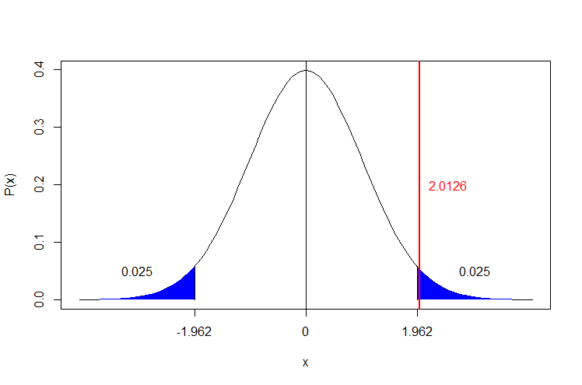
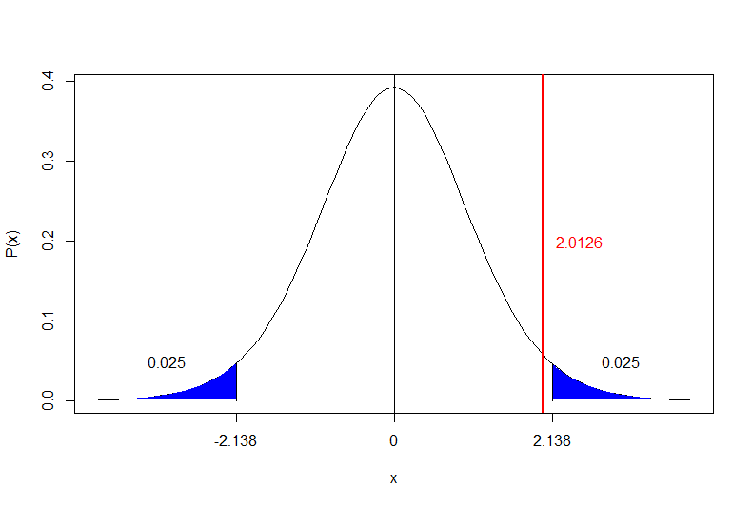

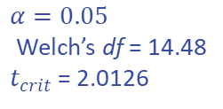
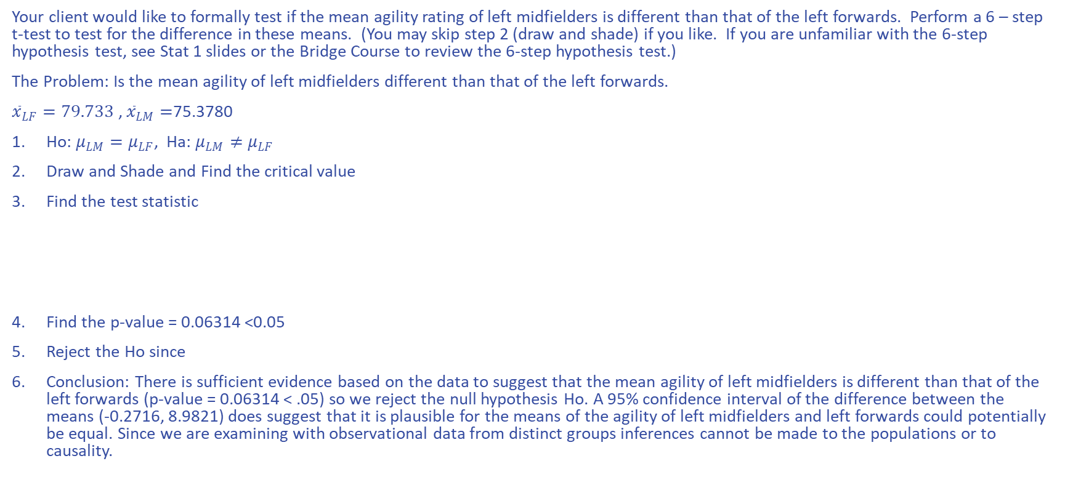

Part 1: We would like to analyze the Left Midfielders (LM) versus the Left Forwards (LF).
Your client would like to formally test if the mean agility rating of left midfielders is different than that of the left forwards. Perform a 6 – step t-test to test for the difference in these means. (You may skip step 2 (draw and shade) if you like. If you are unfamiliar with the 6-step hypothesis test, see Stat 1 slides or the Bridge Course to review the 6-step hypothesis test.)
The Problem: Is the mean agility of left midfielders different than that of the left forwards.
${\overline{x}}_{LF}=79.733$ , ${\overline{x}}_{LM}=$75.3780
Ho: $μ_{LM}=μ_{LF}$, Ha: $μ_{LM}≠μ_{LF}$
Draw and Shade and Find the critical value
Find the test statistic
Find the p-value = 0.06314 <0.05
Reject the Ho since
Conclusion: There is sufficient evidence based on the data to suggest that the mean agility of left midfielders is different than that of the left forwards (p-value = 0.06314 < .05) so we reject the null hypothesis Ho. A 95% confidence interval of the difference between the means (-0.2716, 8.9821) does suggest that it is plausible for the means of the agility of left midfielders and left forwards could potentially be equal. Since we are examining with observational data from distinct groups inferences cannot be made to the populations or to causality.
$$α=0.05$$
df = 1,108
$t_{crit}$= 2.0126
$t_{stat}= \frac{{\overline{x}}_{LF}−{\overline{x}}_{LM}}{Sp \sqrt{\frac{1}{n_{LF}}+\frac{1}{n_{LM}}}}$ = 60.27895
$$α=0.05$$
Welch’s df = 14.48
$t_{crit}$= 2.0126

Slide 6
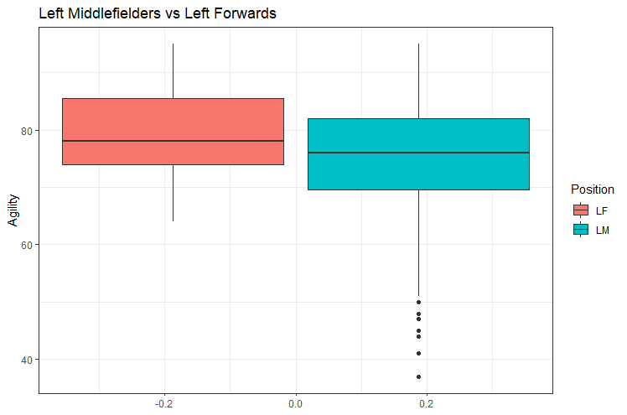
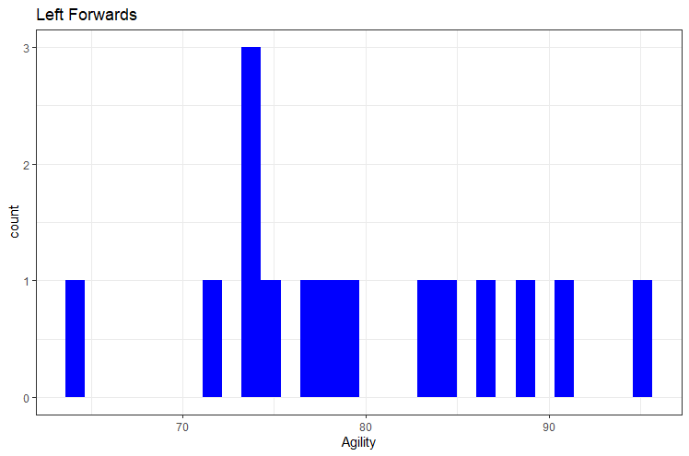
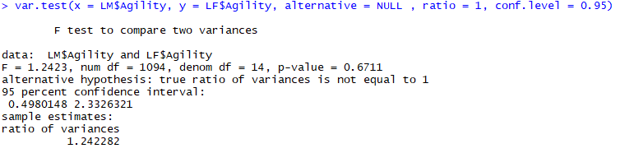
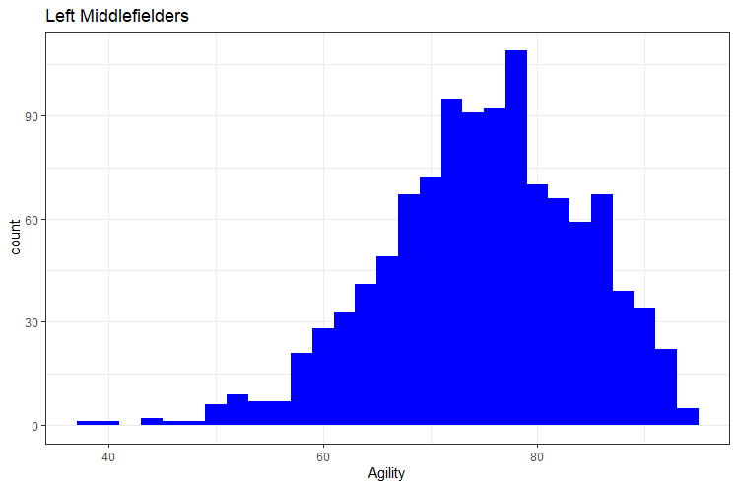
Part 1: We would like to analyze the Left Midfielders (LM) versus the Left Forwards (LF).
Are the assumptions of this test reasonably met? If you have not had Stat 1, simply create a histogram of the agility scores for both groups (LM and LF) and given what you know about the CLT, comment on if you believe the sampling distribution of sample means (of your sample size) will be reasonably normal. In addition, does there look like there is significant visual evidence to suggest the standard deviations are different? ….. If you have had Stat 1, create the plots listed above (and any other plots you might prefer) and be prepared to be a teacher and teach what you know about the assumptions of the t-test and if those are assumption are reasonably met here.
Assumptions for t-test (Justin’s prognosis = failed to meet assumptions for t-test)
Scale: these data appear to follow a continuous scale
Random Sample: these data appear to be randomly sampled observations
Distribution: The LF appears to have a normal distribution but the LM does not appear to have a normal distribution
Sample Size: While there is adequate sample size for LM (n = 1095), there does not appear to adequate sample size for LF (n=15). Based on the CLT, we should have a sample size n>=30.
Variance: We can use the f-test in R to discover if we are working with equal variance between LM and LF datasets, the variances are not equal! BUT, the t-test in R is designed to account for that and uses a Welch’s t-test that assumes the variance are not equal and thus provides an adjustment to the df.

Slide 7
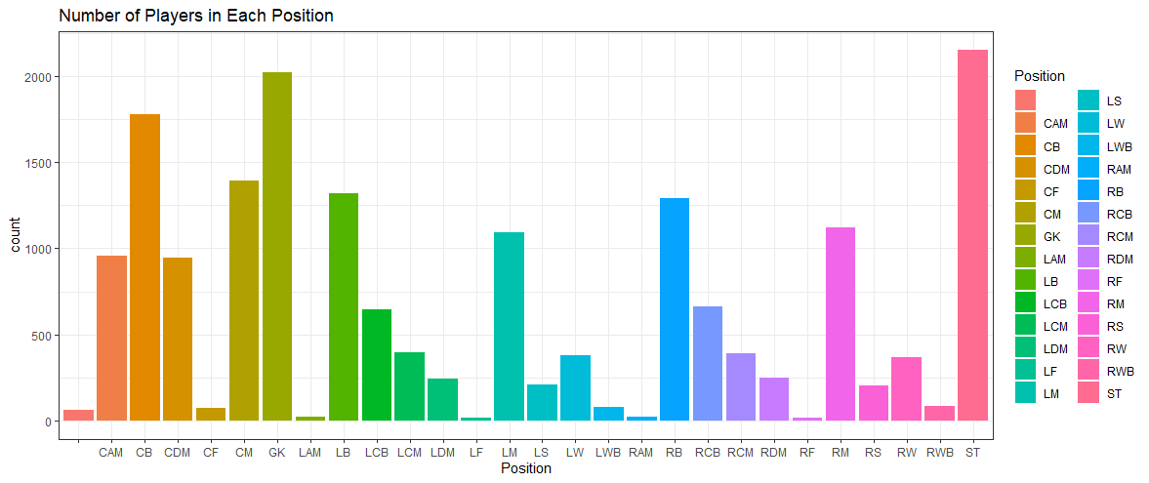
Part 2: Select/create at least 2 categorical variables and select two continuous variables and perform an EDA
Also, at least one of the categorical variables should be created from a continuous variable (using the cut() function).
Use these variables to explore the data and tell a story of what you discovered similar to what was shown in the asynch videos. You do not need to go so far as to use linear regression, but let your curiosity guide you along the way and feel free to use methods you are familiar with that are appropriate to answering those questions. Your evidence could be purely visual or could include additional methods, it is up to you… just do your best and have fun!
Categorical Variables:
Position
CM – Center Midfielder
CB – Center Back
Wage (convert using cut)
Continuous Variables:
Penalties
Position

Slide 8

Part 2: Select/create at least 2 categorical variables and select two continuous variables and perform an EDA
Also, at least one of the categorical variables should be created from a continuous variable (using the cut() function).
Use these variables to explore the data and tell a story of what you discovered similar to what was shown in the asynch videos. You do not need to go so far as to use linear regression, but let your curiosity guide you along the way and feel free to use methods you are familiar with that are appropriate to answering those questions. Your evidence could be purely visual or could include additional methods, it is up to you… just do your best and have fun!
Categorical Variables:
Position
CM – Center Midfielder
CB – Center Back
Wage (convert using cut)
Continuous Variables:
Penalties
Aggression
Attribute Dictionary: https://www.fifauteam.com/fifa-20-attributes-guide/#:~:text=The%20aggression%20level%20of%20a,or%20commitment%20to%20a%20match.

Slide 9
Part 2: Select/create at least 2 categorical variables and select two continuous variables and perform an EDA
Some background on the statistics chosen:
Penalties: “This attribute measures the accuracy of shots from inside the penalty area.” – (https://www.fifauteam.com/fifa-20-attributes-guide/#:~:text=The%20aggression%20level%20of%20a,or%20commitment%20to%20a%20match.)
Penalty Area: “The penalty area -- or the 18-yard box as it's also known -- is an area of the soccer field with its own special rules. As the name implies, some of these rules relate to penalties and the awarding of penalty kicks. But the penalty area serves other purposes as well, limiting when and how the ball can be played.” – (https://www.fifauteam.com/fifa-20-attributes-guide/#:~:text=The%20aggression%20level%20of%20a,or%20commitment%20to%20a%20match.)
Aggression: “The aggression level of a player measures the frequency and the aggression of jostling, tackling and slide tackling. It is the attribute which determines the player’s power of will or commitment to a match. A typical aggression-based action is when you go “shoulder-to-shoulder” against someone, with high aggression our player has the initiative to push the opponent strongly (as far as his strength allows him to) and this determines the winner of the challenge. Another important moment for aggression is when you jump in order to dispute a header. If you play football you know exactly what this is, you jump placing your body against the opponent (if you’re a defender), if you manage to hit the ball with your head, great, if you don’t at least you’ll have to displace the other guy so he can’t perform the header correctly. In this case, aggression needs to work alongside jumping and strength. Players with high aggression offer some risk while inside the area because they can cause a lot of penalties without you pressing a single button, and that could possibly end with you smashing a controller, so be careful when you choose centre backs like this.” – (https://www.fifauteam.com/fifa-20-attributes-guide/#:~:text=The%20aggression%20level%20of%20a,or%20commitment%20to%20a%20match.)
“Center Back (CB): Also known as the central defender, center fullback or stopper, this position plays in the middle of the rear defensive line. A 4–4–2 formation will have two center backs, which will hang back to protect the goal.” – (https://protips.dickssportinggoods.com/sports-and-activities/soccer/soccer-positions-the-numbers-player-roles-basic-formations)
“Central Midfielder (CM): Often considered the most hardworking role, this player has to be ready for action and can play both defensively and offensively, depending on where the ball is. They are responsible for distributing the ball to other players, so it’s vital that they have exceptional ball handling and passing skills. When on the attack, they often take long shots on goal to help the offense. To fit a team’s strategy, they will sometimes line up with the 6 in a more defensive position or with the 10 in a more offensive formation. .” – (https://protips.dickssportinggoods.com/sports-and-activities/soccer/soccer-positions-the-numbers-player-roles-basic-formations)

Slide 10
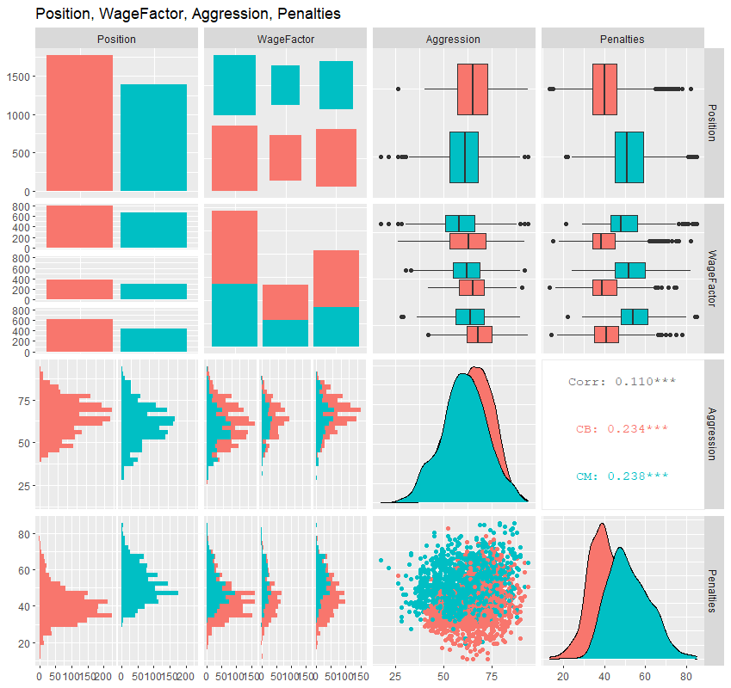
Part 2: Select/create at least 2 categorical variables and select two continuous variables and perform an EDA
Q: CB’s are more aggressive than CM’s.
Confirmed:
CB median_{Aggr} = 65
CM median_{Aggr} = 11
Q: What is the relationship between aggression and penalties?
Judging from the boxplots the more aggressive players less penalties
Confirmed:
CB median_{Plty} = 40
CM median_{Plty} = 51
Q: Does wage have anything to do with aggression?
The higher the wage (broken into WageFactor groups) the more aggressive the player
WF Low (median_{Aggr}) = 60
WF Medium (median_{Aggr}) = 63
WF High (median_{Aggr}) = 67

Slide 11
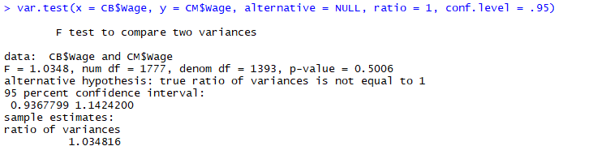
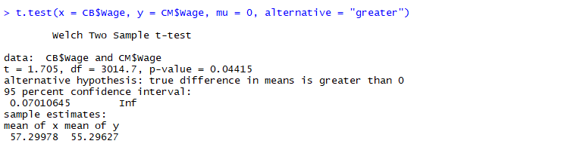
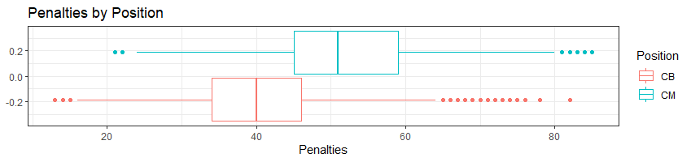
Part 2: Select/create at least 2 categorical variables and select two continuous variables and perform an EDA
Q: Do CB’s earn more money than CM’s?
Test for variance difference using f-test
Welch’s t-test to find out
Ho is rejected and we can conclude that CB’s have a higher mean than CM’s (p-value = 0.0445 < 0.05)
Q: Do CBs or CMs get more penalties, or more attempts at the goal from within the penalty box?
We can visually see that the median for CM’s is higher than the media for CB’s and there is very little overlap between the 1st and 3rd quartile ranges of each.
Conclusion: We now have visual evidence that while CB’s are more aggressive than CM’s, they tend to receive less penalties (take less shots at the goal from within the penalty box) and make more money in all 3 wage factors of low, medium and high.
This makes sense considering where each player is located on the pitch during gameplay, the CM stays towards the middle for of the pitch or the middle of the group of gameplayers from front to back and works on both offense and defense, often providing a segue between the two. It only makes natural sense for the CM’s to be less aggressive (having man to man contests of strength) than the CB’s who are or should be closer to the goal than CM’s during gameplay thus putting them in a more vulnerable position to protect the goal and goalkeeper (GK).
Further, according to my online research the CM should naturally be in a better position to make more attempts at the goal from a closer range than the CBs, such as in the penalty box.

Slide 12
Part 3: Takeaways and Questions for Live Session
When R Studio starts acting up, explicitly call your functions from the library you want to use, e.g. dplyr::summarise(median = median(Aggression)) (summarise = summarize)
Filter – you can filter more than one value using a comma between the variables, you can filter more than one state of the same variable <, >, == using the “pipe” separator “|” that acts like the Boolean operator “OR”; also filter is for rows only
Select is for columns
Mutate is not a permanent state, it is deprecated after use and the original values in the dataframe or tibble remain intact. Permute will drop the original values and replace them with the new values
Group_by – can work with one variable or multiple variables separated with a comma
is.na(x) checks for NAs in the df, !is.na(x) checks that records are not NA
Arrange() puts NAs at the bottom of the column when used
ggpairs is part of the GGally library and is great for getting a cross examination of multiple variables across a variety of graphs all in one summarized space
As.factor() changes records to factors
as.numeric() changes records to numerics
as.character() changes records to characters and removes levels from factors
Covariation means multiple variables
EDA – Exploratory Data Analysis – looking at the data before modeling to summarize characteristics, usually with visuals
Welch t-test assumes unequal variance and will return a df that is adjusted as so. (this is the default in R and is referred to as Satterthwaite in SAS)
F-test can be used to measure variance equality var.test(x = LM$Agility, y = LF$Agility, alternative = NULL , ratio = 1, conf.level = 0.95)
Questions: So far everything seems pretty straight forward, but that doesn’t mean someone else’s question won’t spawn one from me during live session

